Slide 1
Positive Company Culture
Through Transformational Leadership
Richard Trevino II

Slide 2
What EXACTLY is
Transformational Leadership
is a theory of leadership where a leader works with teams to identify needed change, creating a vision to guide the change through inspiration, and executing the change in tandem with committed members of a group
A process that Changes and transforms people that involves:
emotions
values
ethics
standards
long term goals
assessing followers motives, satisfying their needs, and treating them as a human being.

Slide 3
Backstory on
Transformational Leadership
Initially introduced by James V. Downton, the first to coin the term "Transforming leadership"
concept further developed by leadership expert and presidential biographer James MacGregor Burns
Later, researcher Bernard M. Bass expanded upon Burns' original ideas to develop what is today referred to as Bass’ Transformational Leadership Theory
Bass (1985), extended the work of Burns by explaining the psychological mechanisms that underlie transforming and transactional leadership
in contrast to Burns, Bass suggested that leadership can simultaneously display both transformational and transactional leadership.
In 1985, transformational leadership had become more defined and developed
It was determined that Transformational leadership made transactional leadership more effective.

Slide 4
Transactional Leadership
a style of leadership that focuses on supervision, organization, and performance. Transactional leadership is a style of leadership in which leaders promote compliance by followers through both rewards and punishments.

Slide 5
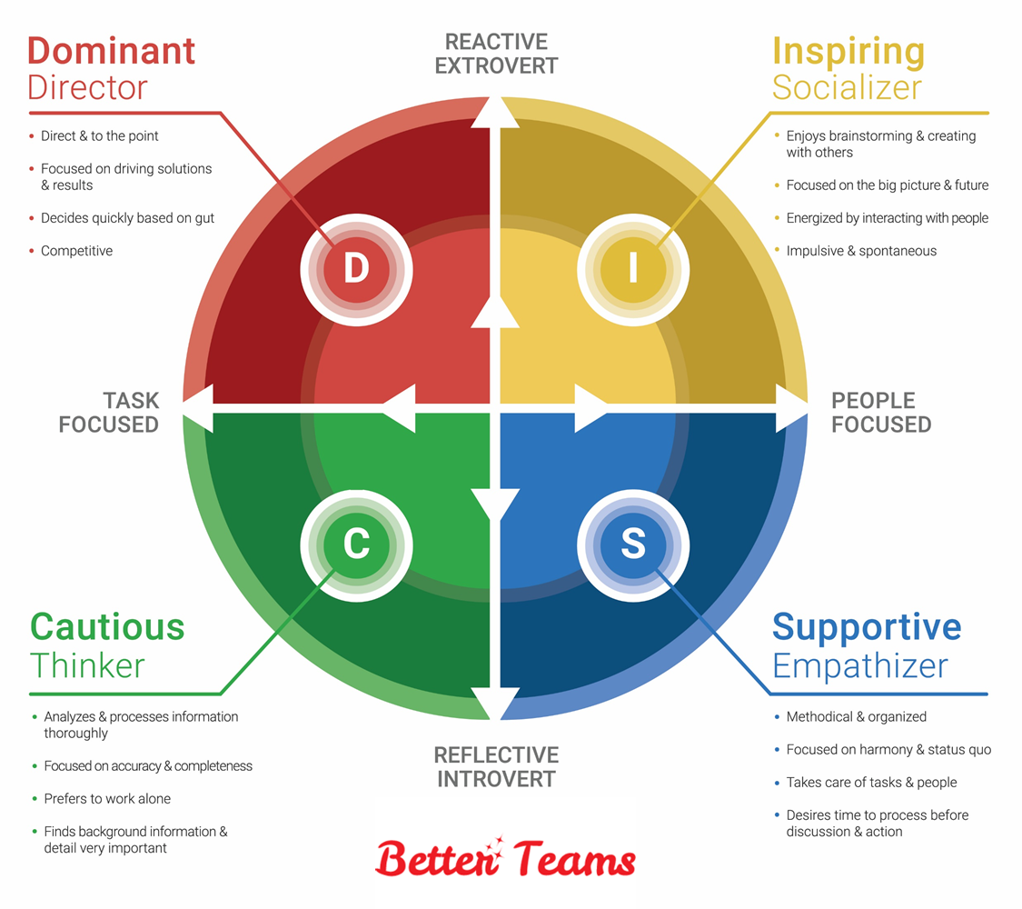
D I S C Profile
D= 3% of population
I= 11% of population
S= 69% of population
C= 17% of population
Notes:
With 80% of the population within I and S (People Focused), there is a very big reason for us to learn to grow in our transformational style of leadership because because these people are more receptive to inspiration and people influence.
The other two are more data driven.

Slide 6
4 I’s
Bass identified 4 components of transformational leadership:
. Idealized Influence: you behave in such a way that people want to emulate that behavior and model them.
. Inspirational Motivation: you may first think someone with charisma but it actually is talking more about someone that can inspire others to a certain vision.
. Intellectual Stimulation: the leader recognizes the fact that other have knowledge, ability, and talents to contribute. This is the person that walks into the room and wants everyone's option and input. people feel valued.
. Individualized Consideration: leader is concerned to know the individual. putting people within the organization where they are able to use their talents. Leader knows what's going on in their peoples lives and coaches them.

Slide 7
Results from
Transformational Leadership
Emphasizes intrinsic motivation and positive development of followers
Raises awareness of moral standards
Highlights important priorities
Fosters higher moral maturity in followers
Creates an ethical climate (share values, high ethical standards)
Encourages followers to look beyond self-interests to the common good
Promotes cooperation and harmony
Uses authentic, consistent means
Uses persuasive appeals based on reason
Provides individual coaching and mentoring for followers
Appeals to the ideals of followers
Allows freedom of choice for followers

Slide 8
Bottom Line…
Transformational Leadership
Inspires, Empowers, and Motivates employees to exceed NORMAL levels of production
Nurtures them into becoming a LOYAL high performer
Lowers Turnover
Promotes team work and cooperation
Employee engagement increases
Company and office culture is more positive and pleasant

Slide 9
People want to work with your company and…
They become productive members of a team!
Notes:
Who he is just striving for this here?! This is what we all want!
If this is what happens, Why isn’t everyone utilizing the Transformational Leadership traits then?!

Slide 10
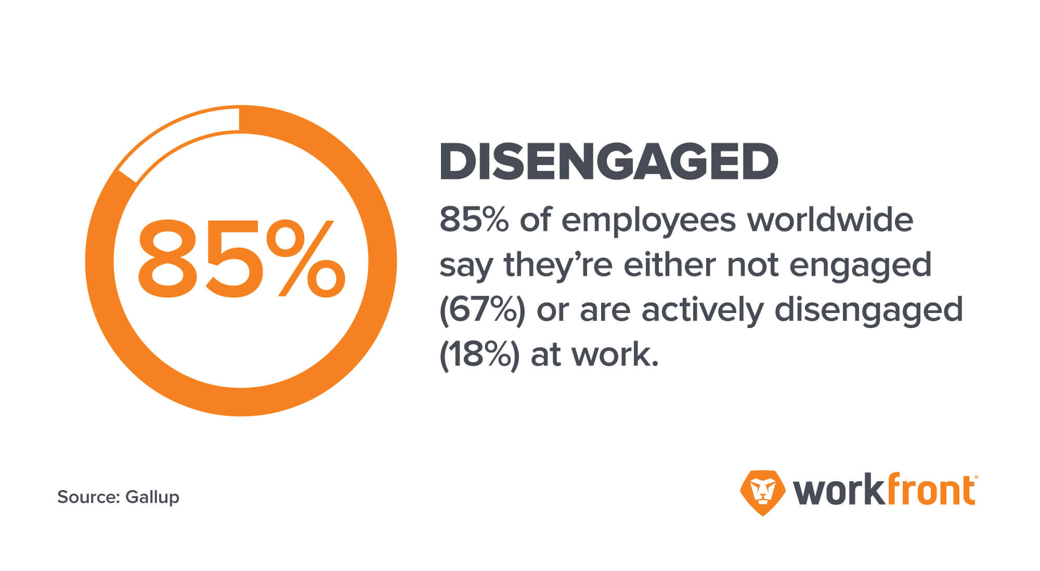
Notes:
Research shows that 70 percent of employee engagement can be attributed to the managers or leaders, but only 15 percent of employees are engaged at work. So we are MISSING SOMETHING!
In a recent study, over 1000 employees and 1000 managers were surveyed and it was found that almost 60 percent of employees say that the single biggest thing they want from their boss/ leader is for him/her to be inspiring; yet only 11 percent answer “YES” when asked if their boss was indeed inspiring.
Another HUGE thing that was discovered is that the managers were not very self Aware. They had given themselves an average of 7 or 8 when their employees voted them as a 3 or 4.
-We must constantly be working on ourselves.
-Read short articles on line.
-youtube motivational videos
-challenge yourself to start getting stronger in an area of your life.
Transformational Leadership is highly fueled by a spirit of optimism and inspiration; this is why we must adopt more traits of the transformational leadership traits into our leadership style.

Slide 11
When you hear the word
TRANSFORMATIONAL…
Notes:
What comes to mind? (ask audience)
What comes to my mind is this…

Slide 12
Notes:
Transformers!
Let me explain why I think of TRANSFORMERS when I think of Transformational leadership.
A few years back, my son was in his room playing…
I chose the dinosaur and he chose the transformer. Why? He said:
“The transformer can be whatever he needs to be. If he needs to walk, he walks. If he needs to fly, he’ll fly. If he needs to drive, he”ll drive. If he needs to fight, he’ll fight.”
We as leaders must be like a chameleon: versatile and able to be different things to different people.
For some we must:
EMPOWER
INSPIRE
CHALLENGE
-What we are, our people will become.
Lions make lions, zebra makes zebras, etc ... Transformers will make other transformers
In order to inspire them, we must first be inspired!
“ “ “ motivate them, we must first be motivated!
“ “ “ have them transform, we first must transform.
How many of you want to inspire, Empower, and Challenge your people?!
How many want your people to be enegaged?
How many want to transform your people into a better version than they currently are?

Slide 13
Where do I begin??
Notes:
Where do I begin?
What mindsets can I adopt to help me be a better transformational leader?
That’s what I want to share with you today: 3 practical things you can do starting today to strengthen your transformational leadership!

Slide 14
1. Keep Your Fire Lit
Notes:
In order to Inspire you must be inspired…
You can’t pour from an empty cup!
How are you refilling yourself? (ask audience)
- Motivational videos
- Church
- Reading Personal development books
- HAVE A MENTOR/ COACH
- Reminding yourself of your WHY/ Your obligations and responsibilities/ the Mission of the company
- Planning a family or personal trip/ have GOALS!
- Do things out of your comfort zone and things that challenge you!
- Exercise and diet… foods change moods!
- Community service
- Listen to music and songs that make you happy, energetic, and put you in a good mood!
All of these things give us a passion for LIFE and IMPACT!
When we are passionate about life, others catch the fire!
It only takes a small fire to start a wildfire!
People want to be around people with good energy! (Elaborate)
Just like negativity is contagious, SO IS POSITIVITY!! (Tell story of guy that went to work and lady said he looked ill.)
Spread the good energy!

Slide 15
2. Empower Your People
Notes:
People lack CONFIDENCE due to a lack of COMPETENCE!
TRAIN regularly! Training isn’t a One-Time Thing; its ongoing.
Make the work exciting, interesting, and fun! (insurance wasn’t fun, but I mad it interesting: FDCPM – Sales Cycle)
Don’t just tell them, but SHOW them how its done. Lead from the front!
Use the DOC system.
Get involved! Knowing you’re in the trenches alone sucks, but knowing your leader is in there with you, makes you know you’re not alone!
One of the biggest things you should be asking your people during 1-on-1’s is:
“How can I support your success?’ “Is there anything I can do for you that would help you do your work better?” “How can I better serve/ lead you?”

Slide 16
3. Challenge Your People
Notes:
People want to work with a company that they feel they are growing as a personal and professional. A good salary and benefits is no longer ALL people want.
-They want to make sure their work has meaning.
-That the company has a bigger vision and impact and they are part of it.
-That their destiny is somehow connected to the company’s.
During this process, they must see growth.
Lou Holtz: “you're either growing or dying!”
Mentoring and coaching your employees frequently is needed.
Setting goals for them and being an accountability partner for them is needed!
Always praising them for their progress but challenging/ motivating them to see how much more than can do is key.
-when people have a challenge and surpass it or overcome, they find gratification in knowing they did more than what they thought they could; and this is the basis for all personal growth!

Slide 17
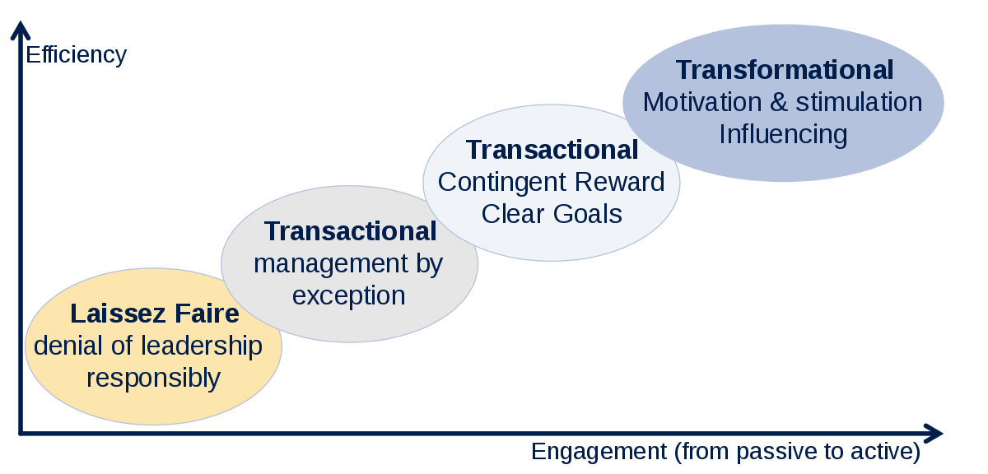
Full Range Model
Notes:
In our journey of becoming more transformational in our leadership, There is a model with a sliding scale: Full Range Model.
STARTS with, Laissez-Faire (LayZayFair) - completely hands off and not engaged with their people. Leaders have little to no contact and no feedback with its people.
Laissez-Fair ——— Transactional Leadership ——— Transformational Leadership
Less impactful - - - - - - - - - - - - Impactful.
Where ever you are in the process, you can choose which direction you want to go into depending on the result that you want.

Slide 18
Remember the Leaders in your Life…
Notes:
When we begin to think about the good and bad leaders/ managers in our life, we all can remember the ones we hated and the ones we loved.
You have a choice to make: What leader you will be to others.
It is because of the good leaders that made a huge impact on us that we are here and better for it. Be that person to them!
Remember, transformational leadership is about leaving people better than the way you found or they came to you.
When we work in the mindset and habits of a Transformational Leader, we begin to slowly change the culture of the office and company.
Remember, its never about what you knew or didn’t know; but what you do with what you now know!

